Slide 1

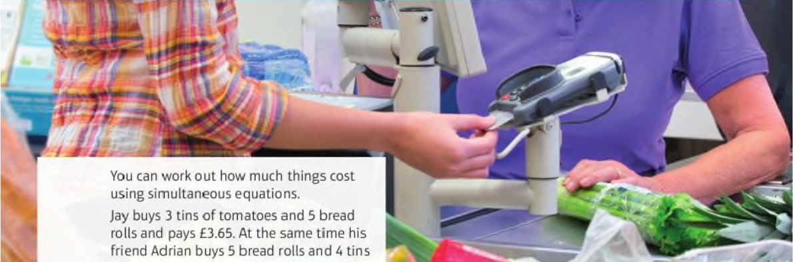
Mathematics (9-1) - iGCSE
2018-20
Year 09
You can work out how much things cost using simultaneous equations.
Jay buys 2 tins of tomatoes and 5 bread rolls and pays £3.65. At the same time his friend Adrian buys 5 bread rolls and 4 tins of tomatoes and pays £4.45. How much does bread rolls cost?
Unit 9 – Equations and Inequalities

Slide 2
Contents
Page iv
9 Equations and inequalities 280
Prior knowledge check 280
9.1 Solving quadratic equations 1 281
9.2 Solving quadratic equations 2 282
9.3 Completing the square 284
9.4 Solving simple simultaneous equations 287
9.5 More simultaneous equations 289
9.6 Solving linear and quadratic simultaneous equations 291
9.7 Solving linear inequalities 293
Problem-solving: Overtaking 296
Check up 297
Strengthen 298
Extend 300
Knowledge check 302
Unit test 303

Slide 3
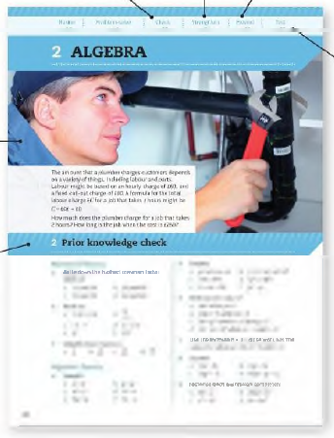
Contents
Page v
At the end of the Master lessons, take a check-up test to help you to decide whether to strengthen or Extend our learning
Extend helps you to apply the maths you know to some different situations
Unit Openers put the maths you are about to learn into a real-life context. Have a go at the question - it uses maths you have already learnt so you should be able to answer it at the start of the unit.
When you have finished the whole unit, a Unit test helps you see how much progress you are making.
Choose only the topics in strengthen thay you need a bit more practice with. You’ll find more hints here to lead you through specific questions. Then move on to Extend
Use the Prior knowledge check to make sure you are ready to start the main lessons in the unit. It checks your knowledge from Key Stage 3 and from earlier in the GCSE course. Your teacher has access to worksheets if you need to recap anything.

Slide 4
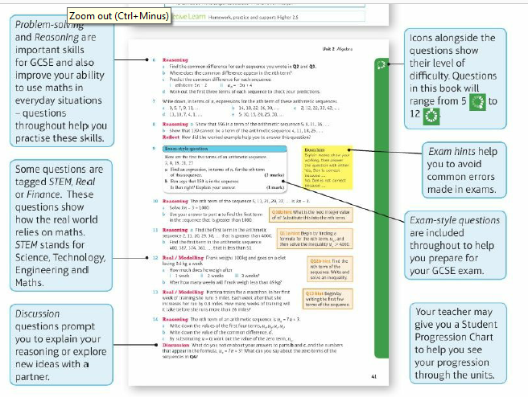
Contents
Page vi

Slide 5
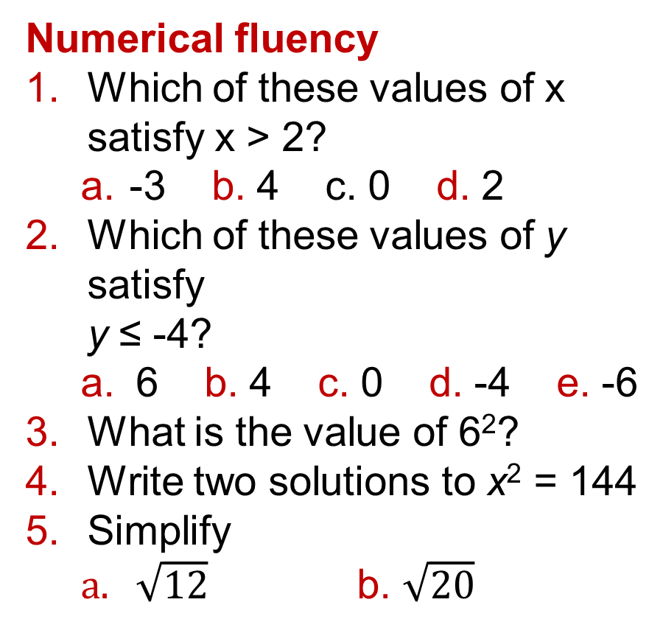
9 – Prior Knowledge Check
Page 280
Numerical fluency
Which of these values of x satisfy x > 2?
  -3 b. 4 c. 0 d. 2
Which of these values of y satisfy
y ≤ -4?
  6 b. 4 c. 0 d. -4 e. -6
What is the value of 6²?
Write two solutions to x² = 144
Simplify
  $\sqrt{12}$ b. $\sqrt{20}$

Slide 6
9 – Prior Knowledge Check
Page 280
Algebraic fluency
Find the value of x² + 5x + 6 when
x = -3
Expand and simplify (x - 4)(x + 3)
Solve to find x
  8z - 6 = 10 b. 9-3z = -6
  4x + 12 = 0
Factorise these expressions.
  x² + 8x b. x² + 4x + 3
  y² - 3y - 10 d. x² - 25
  4 – y²
It costs £53 for 2 adults and 3 children to go ice skating.
Write an equation to show this.
Use x for adult price and y for child price.

Slide 7
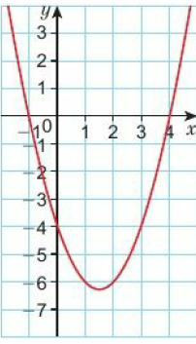
9 – Prior Knowledge Check
Page 280
Graphical fluency
This is the graph
of y – x² -3x = 4.
Use the graph to
solve the
equation
x² – 2x – 4 = 0
* Challenge
Write down two numbers that have a product of 16 and a sum of -10

Slide 8
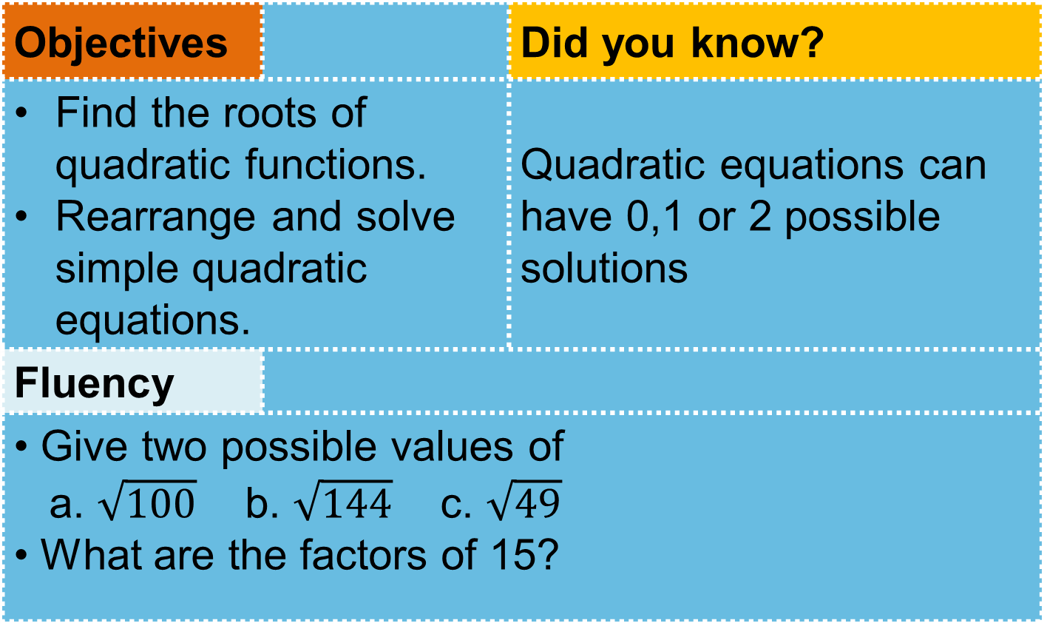
9.1 – Solving Quadratic Equations 1
Page 281
Objectives |  | Did you know?
Find the roots of quadratic functions. Rearrange and solve simple quadratic equations. |  | Quadratic equations can have 0,1 or 2 possible solutions
Fluency
• Give two possible values of a. $\sqrt{100}$ b. $\sqrt{144}$ c. $\sqrt{49}$ • What are the factors of 15?
ActiveLearn - Homework, practice and support: Higher 9.1

Slide 9
9.1 – Solving Quadratic Equations 1
Page 281
Which factor pairs of -12 have a difference of +8?
Factorise
  x² – 5x b. y² – 4
  x² + 3x - 10
Solve to find the value of z.
  3z² = 108
  2z² + 1 = 33
  4z² – 100 = 0
Warm Up
Questions in this unit are targeted at the steps indicated.
Key Point 1
Solving a quadratic equation means finding values for the unknown that fit.

Slide 10
9.1 – Solving Quadratic Equations 1
Page 281
Example 1
Solve x² + 2 - 8 = 0
(x + 4)(x - 2) = 0
So either x + 4 = O
or x - 2 = 0
x = -4 or x = 2
Factorise
The product of the factors if 0 so one or both factors equals 0
Solve the linear equations
Key Point 2
The roots of a quadratic function are its solutions when it is equal to zero.

Slide 11


9.1 – Solving Quadratic Equations 1
Page 281
Find the solutions to these quadratic equations.
  4x² = 64 b. 2x² + 3 = 101
  7x² - 175 = 0
Solve
  x²- 10x + 24 = 0
  x² + x - 30 = 0
  y² + 3y + 2 = 0
  b² - 3b -10 = 0
Q4 hint - Rearrange to make x² the subject. Square root both sides to find two possible values of x.
Q5 hint - Factorise first

Slide 12
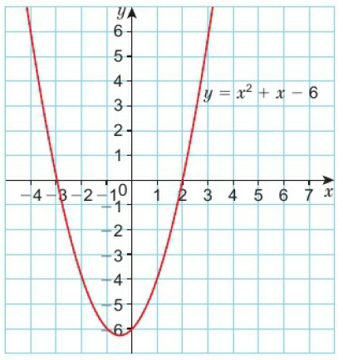
9.1 – Solving Quadratic Equations 1
Page 281
Find the roots of these functions.
  x² - 2x b. x² - 16 c. 4 - y²
a. Use this graph to solve the equation x² + 7x - 6 = 0
  Factorise x² + x - 6 = 0 to show that you get the same solution.

Slide 13
9.1 – Solving Quadratic Equations 1
Page 282
Solve:
  x2 + 7x = -6 b. x2 + x = 12
  x2 + 8 = 6x d. x2 = 7x
Problem-solving – Write any function that will give the roots x = 4 and x = -6.
Discussion – Compare your functions with other people’s.
What other functions are possible?
What do you notice about them all?
Q8a hint – Rearrange into the form x² + ◻x + ◻ = 0

Slide 14
9.2 – Solving Quadratic Equations 2
Page 282
Objectives |  | Did you know?
Solve more complex quadratic equations. Use the quadratic formula to solve a quadratic equation. |  | The work ‘quadratic’ comes from the Latin ‘Quad’ meaning square or four sided.
Fluency
A quadratic equation must contain a squared term – true or false? What two values of x satisfy a. x² = 25 b. x² = 64 c. x² = 225
ActiveLearn - Homework, practice and support: Higher 9.2

Slide 15
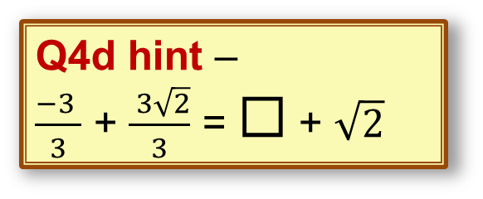
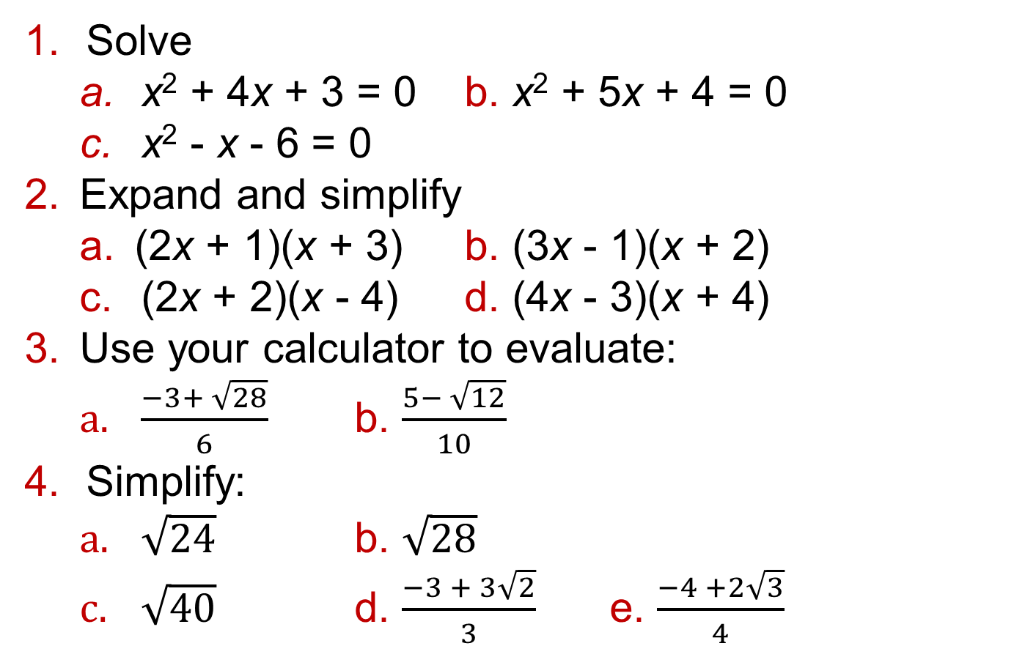
9.2 – Solving Quadratic Equations 2
Page 282
Solve
  x² + 4x + 3 = 0 b. x² + 5x + 4 = 0
  x² - x - 6 = 0
Expand and simplify
  (2x + 1)(x + 3) b. (3x - 1)(x + 2)
  (2x + 2)(x - 4) d. (4x - 3)(x + 4)
Use your calculator to evaluate:
  $\frac{−3+ \sqrt{28}}{6}$ b. $\frac{5− \sqrt{12}}{10}$
Simplify:
  $\sqrt{24}$ b. $\sqrt{28}$
  $\sqrt{40}$ d. $\frac{−3 + 3\sqrt{2}}{3}$ e. $\frac{−4 +2\sqrt{3}}{4}$
Warm Up
Q4d hint –
$\frac{−3 }{3}$ + $\frac{ 3\sqrt{2}}{3}$ = ◻ + $\sqrt{2}$

Slide 16
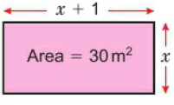

9.2 – Solving Quadratic Equations 2
Page 283
Write and solve
an equation to
find x.
Discussion Why is
only one of the solutions a value for x?
Problem-solving / Modelling Rugs come in several shapes and sizes. A small rug has dimensions a x a.
A large one has dimensions
2a x (a + 1). The area of the Large rug is 12 m².
What are the dimensions of the small rug?
Q4d hint – Draw a diagram. Write an equation for the large rug. Solve to find a.

Slide 17

9.2 – Solving Quadratic Equations 2
Page 283
Copy and complete to factorise the expression. 3x² + 5x - 2 = (3x_______)(x_______)
Factorise the expressions:
  5x² + 15x + 10
  2x² + 3x – 12
  4x² – 6x – 4
  3x² + 5x – 12
  2x² – 7x - 15
Q7 hint – Write the factor pairs of -2 Which factor pair fits 3 x ◻ + 1 x ◻ = 5? Put the factors in the brackets. Then expand and simplify to check you get 3 x 2 + 5x - 2
Q8 hint – First look for any common factors.

Slide 18
9.2 – Solving Quadratic Equations 2
Page 283
Solve
  (2a + 5)(a - 8) = 0
  (2x - 9)(3x + 12) = 0
  (3y - 4)(2y + 5) = 0
  (4b - 3)(3b - 8) = 0
Solve
  2x² - 3x - 5 = 0
  3x² + 5x - 12 = 0
  4x² - 6x - 18 = 0
  6x² + 9x - 15 = 0
Q9a hint – Either 2a + 5 = 0 or a - 8 = 0
Q10a hint – Factorise first by removing the common factor.

Slide 19
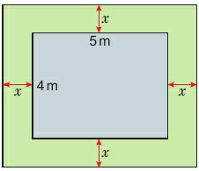
9.2 – Solving Quadratic Equations 2
Page 283
Problem-solving Gerri has a patio that is 4 m x 5 m. She has 10 m2 of turf and wants to use it to make a border round the patio that is the same width all round.
  Write an equation for the area of the grass border,
  Gerri uses all her turf. Solve to find x.

Slide 20
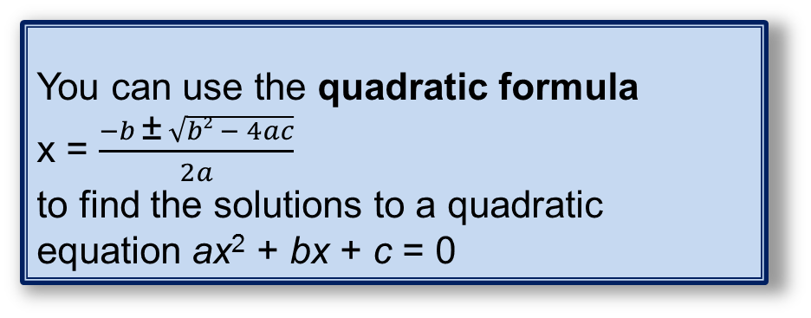
9.2 – Solving Quadratic Equations 2
Page 283
12 – Exam-Style Questions
Solve, by factorising, the equation
8x² - 2x – 21 = 0 (3 marks)
Exam hint
Expand the brackets in your answer to check you get back to the original equation.
Key Point 3
You can use the quadratic formula
x = $\frac{−b \text{±} \sqrt{b2 − 4ac}}{2a}$
to find the solutions to a quadratic equation ax² + bx + c = 0

Slide 21

9.2 – Solving Quadratic Equations 2
Page 284
Example 2
Solve x² + 4x: + 2 = 0. Give your solutions in surd form.
a = 1, b = 4, c = 2
x = $\frac{−4 \text{±} \sqrt{42 −4 x 1 x 2}}{2 x 1}$
= $\frac{−4 \text{±} \sqrt{16 −8}}{2}$
= $\frac{−4 \text{±} \sqrt{8}}{2}$
= $\frac{−4 \text{±} \sqrt{4}\sqrt{2}}{2}$
= $\frac{−4 \text{±} 2\sqrt{2}}{2}$ = -2 ±$2\sqrt{2}$
The solutions are x = -2 + $\sqrt{2}$ and x = -2 - $\sqrt{2}$
Compare with ax² + bx + c. Write the values of a, b and c.
Substitute a, b and c into the quadratic formula.
You are asked to give your solutions in surd form, so simplify the surds.
± means 'plus or minus'.
+ gives one solution and - gives the other.

Slide 22
9.2 – Solving Quadratic Equations 2
Page 284
Solve, giving your solutions in surd form
  x² + 5x + 5 = 0
  x² + 7x + 2 = 0
  x² + 2x - 2 = 0
  x² + 2x - 6 = 0
  3x² + 9x + 5 = 0
Solve, giving your solutions to 2 decimal places
  x² + 6x - 10 - 0
  2x² - 5x - 6 - 0
  3x² + 2x - 2 = 0
  2x² + 3x - 8 = 0
Q14 hint - Use the quadratic formula and a calculator to find the solutions. Round to 2 decimal places.

Slide 23
9.2 – Solving Quadratic Equations 2
Page 284
Solve 2x² - 7x - 15
  by finding factors of -15
  by using the quadratic formula.
Discussion Does it matter which method you use? When is it better to use the formula?
16 – Exam-Style Questions
Solve 5x² + 6x - 2 = 0
Give your solutions correct to 2 decimal places. (3 marks)
June 2013, QIS, 5MB3H/0lJ
Exam hint
You must know the quadratic formula in the exam. Always make sure you give your answer exactly as the exam question asks.
Q16 strategy hint - The instruction to give your solutions correct to 2 decimal places is a hint that you cannot factorise the equation.

Slide 24
9.3 – Completing the Square
Page 284
Objectives |  | Did you know?
Complete the square for a quadratic expression. Solve quadratic equations by completing the square. |  | Completing the square can help you find the maximum or minimum point of a quadratic curve.
Fluency
Which of these expand and simplify to give an x term of 2x? (x + 4)² (x + 2)² (x +1)² (x - 2)²
ActiveLearn - Homework, practice and support: Higher 9.3

Slide 25
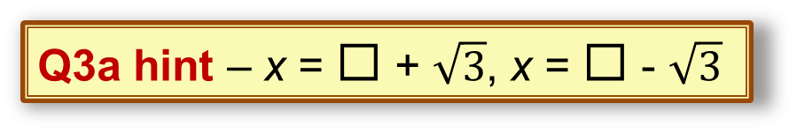
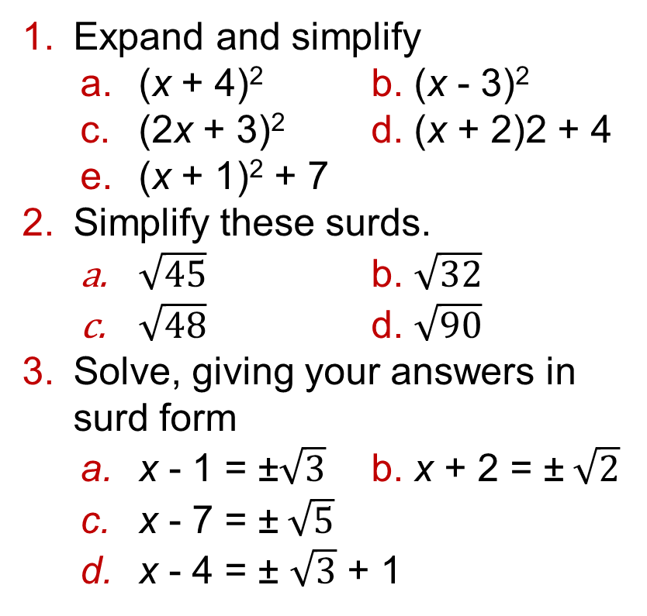
9.3 – Completing the Square
Page 285
Expand and simplify
  (x + 4)² b. (x - 3)²
  (2x + 3)² d. (x + 2)2 + 4
  (x + 1)² + 7
Simplify these surds.
  $\sqrt{45}$ b. $\sqrt{32}$
  $\sqrt{48}$ d. $\sqrt{90}$
Solve, giving your answers in surd form
  x - 1 = ±$\sqrt{3}$ b. x + 2 = ±$\sqrt{2}$
  x - 7 = ±$\sqrt{5}$
  x - 4 = ± $\sqrt{3}$ + 1
Warm Up
Q3a hint – x = ◻ + $\sqrt{3}$, x = ◻ - $\sqrt{3}$

Slide 26
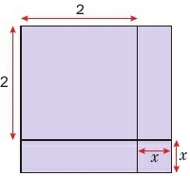
9.3 – Completing the Square
Page 285
Write a quadratic expression for the area of the large square.
Q4 hint – Write an expression with two brackets. Expand to get a quadratic expression.
Key Point 4
Expressions such as (x + 2)², (x - 1)² and (x + ½)² are called perfect squares.

Slide 27
9.3 – Completing the Square
Page 285
Write these expressions in the form (x + 2)² + ◻ or
(x + 2)² - ◻
  x² + 4x + 5 b. x² + 4x + 6
  x² + 4x – 1
Write these as perfect squares.
  x² + 6x + 9 b. x² + 8x + 16
  x² + 10x + 25
  x² + 12x + 16
Q5a hint - Compare the expression with your answer to Q4.

Slide 28
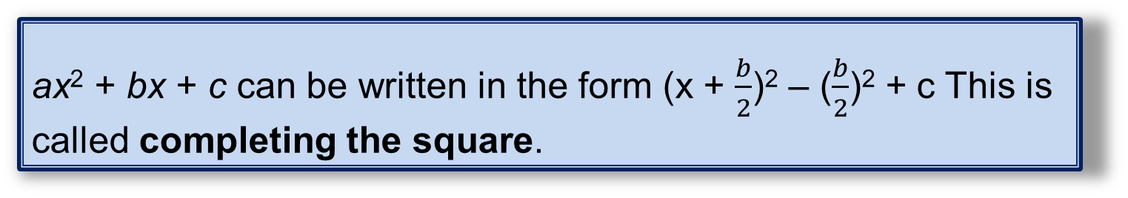
9.3 – Completing the Square
Page 281
Example 3
Write x² + 2x + 7 in the form
(x + p)² + q
[x² + 2x] + 7
x² + 2x = (x + 1)² - 1
So [x² + 2x] + 7 = [(x + 1)² - 1] + 7
= (x + 1)² + 6
So p = 1 and q = 6
Separate the x terms from the constant.
Find the perfect square which will give the correct x² and x terms, then subtract the constant to make the identity true.
Substitute the identity into the original expression.
Simplify the expression
Compare (x + 1)² + 6 with (x + p)² + q and write down the values.
Key Point 2
ax² + bx + c can be written in the form (x + $\frac{b}{2}$)² – ($\frac{b}{2}$)² + c This is called completing the square.

Slide 29
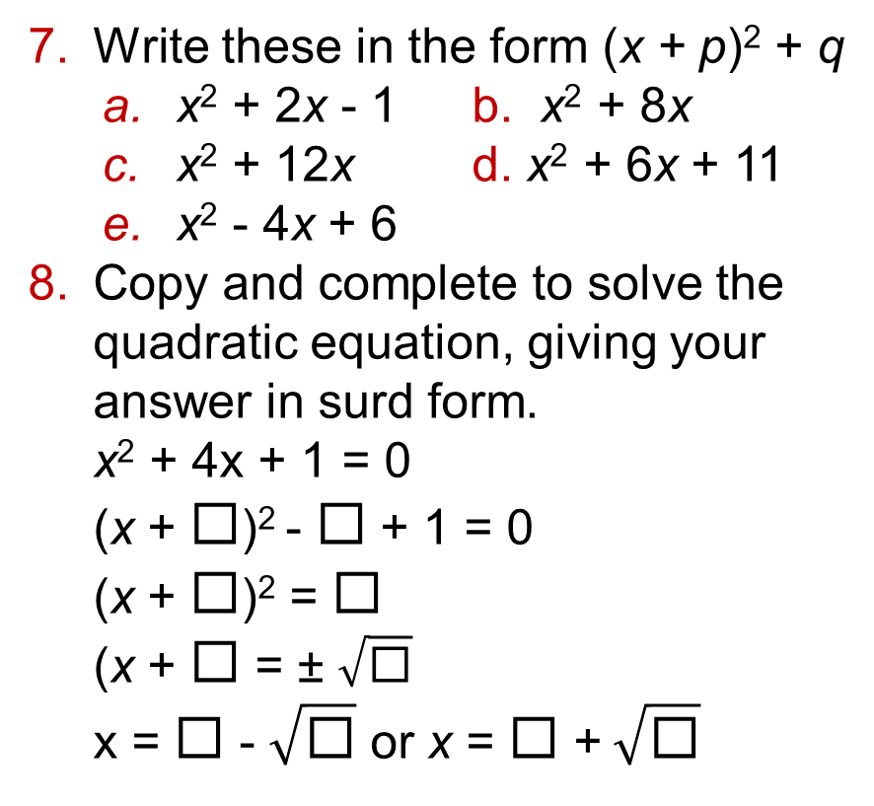
9.3 – Completing the Square
Page 285
Write these in the form (x + p)² + q
  x² + 2x - 1 b. x² + 8x
  x² + 12x d. x² + 6x + 11
  x² - 4x + 6
Copy and complete to solve the quadratic equation, giving your answer in surd form.
x² + 4x + 1 = 0
(x + ◻)² - ◻ + 1 = 0
(x + ◻)² = ◻
(x + ◻ = ± $\sqrt{\text{◻}}$
x = ◻ - $\sqrt{\text{◻}}$ or x = ◻ +$\sqrt{\text{◻}}$
Q8 hint - Complete the square first.

Slide 30

9.3 – Completing the Square
Page 286
Solve these quadratic equations, giving your answer in surd form.
  x² + 6x + 7 = 0
  x² + 2x - 5 = 0
  x² + 8x + 9 = 0
Copy and complete to write the expression 3x² – 12x -1 in the form p(x + q)² + r
3x² – 12X -1 = 3 (◻ - ◻) -1
= 3[(x - ◻)² - 1
= 3(x - ◻)² - ◻ - 1
= 3(x - ◻)² - ◻
Q9 hint - Follow the method used in Q8.
Q9 hint - Factorise the x² and x terms. Then complete the square for the expression inside the brackets.
Simplify so that you have p(x + q)² + r

Slide 31
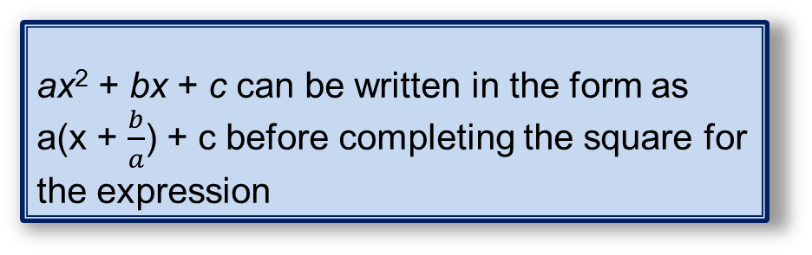
9.3 – Completing the Square
Page 286
Key Point 6
ax² + bx + c can be written in the form as
a(x + $\frac{b}{a}$) + c before completing the square for the expression
Write these in the form a(x + p)² + q
  2x² + 12x + 2 b. 3x² - 6x + 5
  5x² + 10x + 25 d. 4x² + 12x – 7
Solve these equations by completing the square.
Give your answer in surd form
  2x² - 12x + 2 = 0
  3x² + 12x - 3 = 0
Q11 hint - Follow the method used in Q10.
Q12 hint - Complete the square first. Then solve.

Slide 32
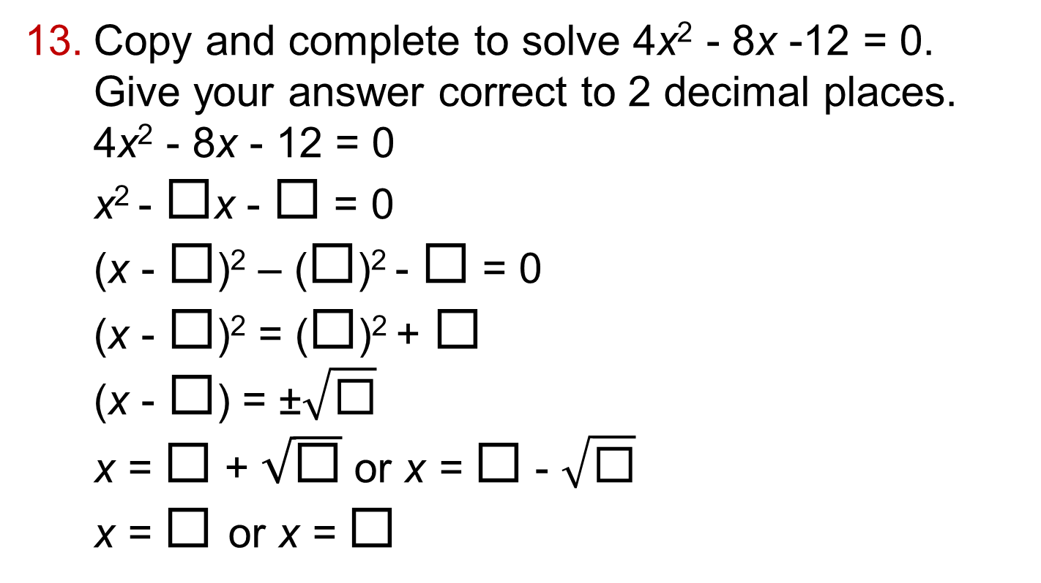
9.3 – Completing the Square
Page 286
Copy and complete to solve 4x² - 8x -12 = 0.
Give your answer correct to 2 decimal places.
4x² - 8x - 12 = 0
x² - $\text{◻}$x - $\text{◻}$ = 0
(x - $\text{◻}$)² – ($\text{◻}$)² - $\text{◻}$ = 0
(x - $\text{◻}$)² = ($\text{◻}$)² + $\text{◻}$
(x - $\text{◻}$) = ±$\sqrt{\text{◻}}$
x = $\text{◻}$+ $\sqrt{\text{◻}}$ or x = $\text{◻}$ - $\sqrt{\text{◻}}$
x = $\text{◻}$or x = $\text{◻}$
Divide every term by the coefficient of x², 4
Complete the square for the first two terms.
Rearrange the terms
Take the square root of both sides

Slide 33
9.3 – Completing the Square
Page 286
Solve these quadratic equations, giving your answer correct to 2 decimal places.
  2x² + 4x - 8 = 0 b. 6x² -3x - 2 = 0
  3x² + 6x - 10 = 0
  5x² - 15x - 4 = 0
  4x² + 6x - 5 = 0
Discussion Which is more accurate, giving an answer as a surd or to 2 decimal places?
Q14 hint - Follow the method used in Q13.
14 – Exam-Style Questions
Exam hint
When you are told the method to use, make sure you use this method.
Solve 6x² + 3x - 13 = 0 by completing the square. Give your answer correct to 2 decimal places. (3 marks)

Slide 34
9.4 – Solving Simple Simultaneous Equations
Page 284
Objectives |  | Did you know?
Solve simple simultaneous equations Solve simultaneous equations for real-life situations. |  | Simultaneous means ‘at the same time’. The only way to solve equations in two variables is to have two equations that both variables satisfy.
Fluency
When y = 3, what is: a. 2y b. -3y c. 5y²
ActiveLearn - Homework, practice and support: Higher 9.4

Slide 35
9.4 – Solving Simple Simultaneous Equations
Page 287
Rearrange these equations to make b the subject.
  b - 12 = 2a b. 2b + 6c=10
  5a – 3b = 5
2 Write an equation for each of these,
  The sum of x and y is 12.
  The difference between x and y is 4.
Which of these have the
value 0 for any value of the variable?
  -3y + (-3y) b. 2y - (-2y)
  -4x + 4x d. -3z - (-3z)
Warm Up

Slide 36
9.4 – Solving Simple Simultaneous Equations
Page 287
Key Point 7
When there are two unknowns, you need two equations to find their values. These are called simultaneous equations.
Solve the simultaneous equations
  y = 3y b. y = 5
  2x + 0 = 11 3x - y = 4
  y = -6 d. y = 4x
  3x + 2y = 30 3x + 2y = 11
  y = x + 2 f. x = 3y + 3
  x + y = 20 x + 3y = 17
  y – 3x = 0 h. 2x - y = 26
  2x + 2y = 24 5x + 4y = 26
Q4c hint - When y = -6, 2y = ◻ Substitute this value into the second equation.
Q4c hint - Substitute the value of 0 into the second equation: * + * + 2 = 20
Q4g hint - Rearrange the first equation to make y the subject.
Q4a hint - Substitute the value of y into the second equation: 2x + ◻ = 11. Now solve.

Slide 37
9.4 – Solving Simple Simultaneous Equations
Page 287
Problem-solving Two meals and a bottle of wine cost £36. The bottle of wine costs £3 more than a meal.
How much is one meat?
How much is a bottle of wine?
Problem-solving / Modelling Jake buys 2 lamb chops and 2 sausages and pays £7 for them. At the same time Jamie buys 3 lamb chops and 4 sausages and pays £11.
How much does a sausage cost?
Q5 strategy hint - Let the cost of a meal be x and the wine be y. Write an equation for the first sentence. Write an equation for the second sentence.

Slide 38
9.4 – Solving Simple Simultaneous Equations
Page 288
Example 4
Solve the simultaneous equations
x + y = 6
3x - y = 10
① x + y = 6
② 3x – y = 10
① + ② 4x + 0 = 16
x = 4
4 + y = 6
y = 2
Check:3 x 4 – 2 = 10 ✓
The terms in y have opposite signs, so add the equations to eliminate the terms in y.
Divide both sides by 4
Substitute x = 4 into equation ①
Rearrange the first equation to make y the subject.

Slide 39
9.4 – Solving Simple Simultaneous Equations
Page 288
Solve these simultaneous equations.
  2x - y = 4 b. 5x + y = 15 c. 4x- 3y = 10
  3x + y = 11 2x + y = 3 5x - 3y = 14
Antony solves simultaneous equations in this way
3x – y = 8
x + y = 4
y = 4 – x
3x - (4 + x) = 8
3x + x - 4 = 8
4x = 12
x = 3
3 + y = 4
So y = 1
(3 x 3) - 1 = 8 ✓
Solve the simultaneous equations in Q7a using Antony's method. Reflect Which method do you prefer?
Write the second equation with y as the subject.
Substitute y = 4 - x into the first equation.
Collect like terms to find x.
Now, substitute x = 3 into the second equation.
Check that the solutions work by substituting them into the first equation.

Slide 40
9.4 – Solving Simple Simultaneous Equations
Page 288
Copy and complete to solve the simultaneous equations.
  4x - 2y = 16 ①
  3x + u = 17 ②
  ◻x + 2y = ◻ ③
  Add equations and . Find x.
  4x - 2y = 16 ①
  ◻x + 2y = ◻ ③
  ◻x + 0 = ◻
  x = ◻
  Substitute your value of x into equation ③ to find y.
Q9 hint - Multiply every term in equation by 2
Q9 hint - Add equations ① and ③

Slide 41
9.4 – Solving Simple Simultaneous Equations
Page 288
Solve these simultaneous equations,
  x + 5y = 22 b. 3y -2x = 16
  4x - y = 4 x + 4y = 14
  5x + 3y = 21 d. 3x - 2y = -7
  3x + y = 11 5y - x = 7
Discussion How do you decide what number to multiply by?
Q10 hint - Follow the method used in Q9.
11 – Exam-Style Questions
Exam hint
Substitute your values of x and y back into each equation to check they fit.
Solve the simultaneous equations
4x + 3y = 5
2x + y = 3 (3 marks)

Slide 42
9.4 – Solving Simple Simultaneous Equations
Page 289
Solve the simultaneous equations 5x + y = 0
x + 5y = 0
Discussion Does it matter which equation you multiply?
Finance / Problem-solving A telephone company charges £x per month for a basic line rental and then £y per 100 minutes. Justin pays £18 for 200 minutes. Teresa pays £21 for 300 minutes.
  Work out the cost of the monthly rental,
  How much would Caron pay for 400 minutes?
Q12 hint - First solve by multiplying the first equation by 5. Then solve by multiplying the second equation by 5.

Slide 43
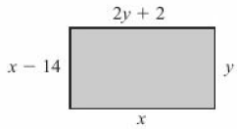
9.4 – Solving Simple Simultaneous Equations
Page 289
Problem-solving The sum of two numbers is 23 and their difference is 5. Let the two numbers be x and y. Write two equations and solve them to find the two numbers.
15 – Exam-Style Questions
The diagram
shows a
rectangle. All
sides are
measured in
centimeters. Jean says the perimeter of the rectangle is more than 75 cm. Show that Jean is correct. (5 marks)
Q15 strategy hint - Set up two simultaneous equations and solve them.

Slide 44
9.5 – More Simultaneous Equations
Page 289
Objectives |  | Did you know?
Use simultaneous equations to find the equation of a straight line. Solve linear simultaneous equations where both equations are multiplied. Interpret real-life situations involving two unknowns and solve them. |  | Sometimes you need to multiply both equations to eliminate a term.
Fluency
What is the equation of a straight line?
ActiveLearn - Homework, practice and support: Higher 9.5

Slide 45
9.5 – More Simultaneous Equations
Page 289
Multiply each equation by 4
  2x + 3y = 6 b. x - 6y = 7
Solve these simultaneous equations.
  y + 2x = 8 b. 3y + 2x = 14
  2y - 2x = 4 5y + x = 14
Warm Up
a. Write the equation of a line
through (2,5)
  Write the equation of a line through (3,8)
  Solve your simultaneous equations from parts a and b to find m and c.
  Write the equation of the line through the points (2,5) and (3,8).
Q3a hint - Substitute x = 2, y = 5 into y = mx + c
Q3d hint - Substitute your values of m and c from part c into y = mx + c

Slide 46
9.5 – More Simultaneous Equations
Page 290
Find the equation of the line through the points (6, -3) and (-2, 5).
Example 5
Solve the simultaneous equations
5x + 2y = 16
4x - 3y = -1
① 5x + 2y = 16 ① x 3: 15x + 6y =48 ③
② 4x – 3y = -1 ② x 2: 8x – 6y = 02 ④
③ + ④ 23x = 46
x = 2
10 + 2y = 16
2y = 6
y = 3
Check: 4 x 2 – 3 x 3 = 8 – 9 = -1 ✓
Multiply equation ① by 3 and equation ② by 2 to make the coefficients of 0 equal.
Add these equations to eliminate y.
Substitute x = 2 into equation ①
Check your answers by substituting into equation ②

Slide 47
9.5 – More Simultaneous Equations
Page 290
Solve these simultaneous equations,
  5x + 3y = 13 b. 3x + 2y = 13
  4x - 2y = 6 4x + 4y = 20
  4x + 7y = 1 d. 2x + 5y = 46
  3x + 7y = 34 5x + 2y = 8
  4x + 1.5y = 7
  5x + 2y = 8
Problem-solving / Modelling A coffee shop menu shows deals of the day as one coffee and two scones for £3.80, or two coffees and two scones for £5.80.
Work out the cost of a coffee and the cost of a scone.

Slide 48
9.5 – More Simultaneous Equations
Page 290
Problem-solving / Modelling Daniel pays for two children and himself to go into a sports centre. His friend pays for an adult and three children.
Daniel pays £3.80 for the tickets and his friend pays £4.80.
How much is an adult ticket and how much is a child's ticket?
Problem-solving / Modelling Amy buys two bananas and three pears in a shop and pays £1.95.
At the same time Jacob buys three bananas and five pears and pays £3.05.
What is the cost of a pear? What is the cost of a banana?

Slide 49
9.5 – More Simultaneous Equations
Page 290
9 – Exam-Style Questions
Solve the simultaneous equations.
3x – 4y = 8
9x + 5y = -1.5 (3 marks)
June 2012, QJ6b, 5MB3H/01
Problem-solving A van can carry 300 kg. Two possible maximum loads are 4 bags of cement and 7 bags of sand, or 6 bags of cement and 3 bags of sand.
What is the mass of a bag of sand? What is the mass of a bag of cement?
Exam hint
Number the equations and show any multiplying, adding or subtracting clearly.

Slide 50
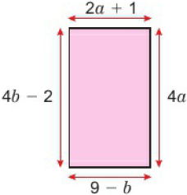
9.5 – More Simultaneous Equations
Page 291
Problem-solving Hire charges for a mini bus consist of £x fixed charge + y pence for each mile of the journey.
A hire for 20 miles costs £25.
A hire for 30 miles costs £30.
How much would a hire for 50 miles cost?
The diagram shows
a rectangle with all
measurements in
metres.
  Write down a pair
  of simultaneous
  equations in a and b.
  Solve the equations,
  Give the dimensions of the rectangle.
Q12a hint - Rearrange your equations so that they are both ◻a + ◻b = ◻

Slide 51
9.6 - Solving linear and quadratic simultaneous equations
Page 289
Objectives |  | Did you know?
Solve simultaneous equations with one quadratic equation. Use real-life situations to construct quadratic and linear equations and solve them. |  | A quadratic expression is a way of describing the area of a rectangular shape.
Fluency
Which of these equations is a linear b quadratic c a circle? x² – 4x + 2 = 0 y = 4 – 3x x² + y = 16 y + x = 4
ActiveLearn - Homework, practice and support: Higher 9.6

Slide 52
9.6 - Solving linear and quadratic simultaneous equations
Page 291
Solve these quadratic equations,
  x² + 3x - 4 = 0
  2x² - x - 3 = 0
  6x² + 10x - 4 = 0
Use the quadratic formula to solve these equations, giving your answer to 2 d.p.
  x² + 3x - 5 = 0
  3x² - x - 3 = 0
  2x² + 5x - 3 = 0
Find the length of the line joining A(2,9) to B(-4,1).
Warm Up

Slide 53
9.6 - Solving linear and quadratic simultaneous equations
Page 292
Example 6
Solve these simultaneous equations.
① 2x + 0 = 3
② x + y -6.
y = 3 - 2x
x² + (3 - 2x) = 6
x² - 2x + 3 = 6
x² - 2x - 3 = 0
(x + 1)(x - 3) =0
So either (x + 1) = 0 or (x - 3) = 0
x = -1 or x = 3
2 x (-1) + y = 3
-2 + y = 3
y = 5
2 x 3 + y = 3
6 + y = 3
y = -3
So the solutions are x = -1, y = 5 and x = 3, y = -3
Rearrange equation ① to make y the subject.
Substitute y = 3 - 2x into equation ②
Expand the bracket and rearrange so the right-hand side is 0.
Solve the quadratic equation.
Substitute x = -1 into equation ① to find one value of y.
Substitute x = 3 into equation ① to find the second value of y.

Slide 54
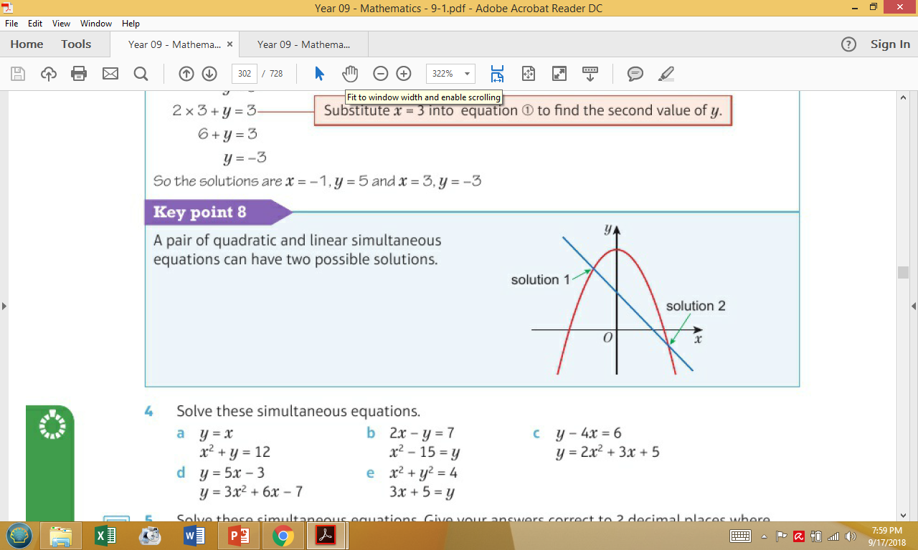
9.6 - Solving linear and quadratic simultaneous equations
Page 292
Key Point 8
A pair of quadratic
and linear
simultaneous
equations can have
two possible solutions.
Solve these simultaneous equations.
  y = x b. 2x - y = 7
  x² + y= 12 x² - 15 = y
  y - 4x = 6
  y = 2x² + 3x + 5
  y = 5x - 3 e. x² + y² = 4
  y = 3x² + 6x - 7 3x + 5 = y

Slide 55
9.6 - Solving linear and quadratic simultaneous equations
Page 292
Solve these simultaneous equations. Give your answers correct to 2 decimal places where appropriate.
  y + 3x = 8 b. 2y - 4x = 6
  y = x² + 2x + 4 y = x² + x – 5
A curve with equation y = x²- 4x - 1 crosses a straight line with equation y = 2x- 1 in two places. Find the coordinates of the points where they intersect.
Key Point 9
To find the coordinates where two graphs intersect, solve their equations simultaneously.

Slide 56
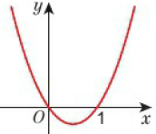
9.6 - Solving linear and quadratic simultaneous equations
Page 292
Reasoning The diagram shows a sketch of the curve y = 4(x² - x).
The curve crosses the straight line with equation y = 4 - 4x
at two points.
Find the coordinates of
the points where they
intersect.
Solve these simultaneous equations.
  y = 2x² + x - 2 b. y = 4x² - x - 6
  x + y = 2 y = 2 - x
  y = x² + 6x + 5 d. y = 3x² - 4x - 2
  y = 5 + x y = 2x - 3
  y = 2x – 1 f. 3y = x + 6
  y² = 4x + 13 y² = 2x + 7

Slide 57
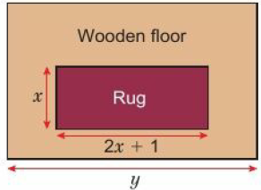
9.6 - Solving linear and quadratic simultaneous equations
Page 293
Reasoning The diagram shows a rug laid on a wooden floor. Its width is 2m less than the width of the room,
  Write an equation to represent the width of the room (y).
  Write an equation to represent the area of the rug, which is 3 m².
  Use these two equations to find the value of x and hence the width of the room
  (y).

Slide 58
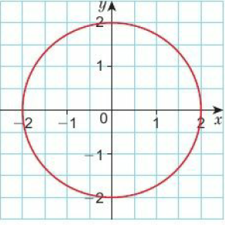
9.6 - Solving linear and quadratic simultaneous equations
Page 293
10 – Exam-Style Questions
Exam hint
There are 2 marks each for finding A and B, and 2 marks for finding the length AB.
C is the curve with equation y = x² - 6x + 6.
L is the straight line with equation y = 2x - 9
L intersects C at two points, A and B. Calculate the exact length of AB.
(6 marks)
Reasoning The diagram shows a circle of diameter 4 cm with centre at the origin,
  Write the equation for the circle,
  Use an algebraic method to find the points where the line
  y = 2x - 1 crosses the circle.
Q12b hint - Substitute y = 2x -1 into your equation from part a.

Slide 59
9.6 - Solving linear and quadratic simultaneous equations
Page 293
Solve these simultaneous equations. Give your answers correct to 3 significant figures,
  x2 + y2 = 28
  y = x + 3
  x2 + y2 = 35
  y = 2 + 5x
  x2 + y2 = 50
  y = 3 + 2x
Q12b hint - Substitute y = 2x -1 into your equation from part a.

Slide 60
9.7 - Solving Linear Inequalities
Page 289
Objectives |  | Why learn This?
Solve inequalities and show the solution on a number line and using set notation. |  | Anything you can do with an equation you can also do with an inequality. It helps us to consider a wider range of potential answers to problems.
Fluency
Which is true for -2 < x < +2? x lies between -2 and +2 but is equal to neither. x is bigger than +2 and smaller than -2. x is greater than or equal to -2 and less than or equal to +2. x is equal to either -2 or +2.
ActiveLearn - Homework, practice and support: Higher 9.7

Slide 61

9.7 - Solving Linear Inequalities
Page 294
Solve to find x
  5 – 4x = 3
  4 - 2x = 6 – 3x
  4x = 2(2 - x)
  9 - 5x = 21 + x
For each inequality, choose three possible integer values for x from the cloud,
  x ≥ 35
  b. x < 4
  3x + 1 > 4
  5x -3 >2
  -5 < x ≤ 3 f. 0 < x ≤ 4
  3 > x ≥ -3
Warm Up

Slide 62

9.7 - Solving Linear Inequalities
Page 294
Write down four integers that satisfy each inequality.
  x + 2 > 3 b. x -1 < 0
  3x + 1 > 4 d. 5x - 3 > 2
  -5 < x ≤ 3 f. 0 < x ≤ 4
  3 > x ≥ -3
Key Point 10
You can show inequalities on a number line.
An empty circle O shows that the value is not included.
A filled circle ● shows that the value is included.
An arrow O→ shows that the solution continues towards infinity.
You can rearrange an inequality in the same way as you rearrange an equation.

Slide 63
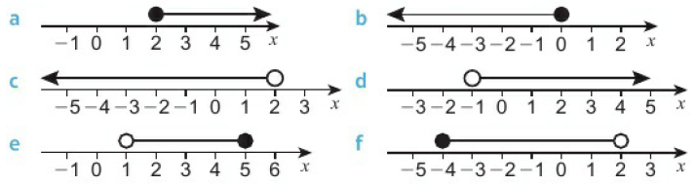
9.7 - Solving Linear Inequalities
Page 294
Write the inequalities that these number lines represent for x,
Q4a hint – x ____ 2
Q4e hint –
1 ___ x ____5

Slide 64
9.7 - Solving Linear Inequalities
Page 294
5 – Exam-Style Questions
-4 < n ≤ 1 where n is an integer.
Write down all the possible values of n. (2 marks)
Write down the inequality represented on the number line.
(2 marks)
March 2013, Q4, 5MB3H/0IJ
n
-5 -4 -3 -2 -1 0 1 2 3 4 5
Q5b strategy hint - Write your inequality in terms of x.

Slide 65
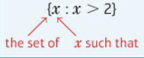
9.7 - Solving Linear Inequalities
Page 294
Draw number lines to show these inequalities.
  x ≥ 1 b. 1 ≤ x ≤ 5
  -1 < x < 3 d. 0 > x ≥ -2
Discussion Are number lines a good way to represent inequalities?
{x: x > 3} means the set of all x values such that x is greater than 3. Write the meaning of these sets,
  {x: < 2) b. {x: x ≤ -2} c. {x: x ≥ 0}
  {x: x ≤ 0} e {x: x > -1}
Key Point 11
You can write the solution
to an inequality using set
notation.

Slide 66
9.7 - Solving Linear Inequalities
Page 295
Example 7
Solve 3x - 2 > 6 - x. Show your answer on a number line and write the solution
set using set notation.
3x > 6 – x + 2
4x > 8
x > 2
In set notation; {x : x > 2}
Add 2 to both sides
Add x to both sides
Divide both sides by 4
This tells us that there is a set of values of x, not just one value.

Slide 67
9.7 - Solving Linear Inequalities
Page 295
Solve each inequality and show your answer on a number line. Write the solution set using set notation.
  4x > 12 b. 5x < 10
  3x - 5 > 4 d. 2x + 3 ≤ 7
10 – Exam-Style Questions
3x + 5 > 16, where x is an integer. Find the smallest value of x.
(3 marks)
Nov 2012, QI, 5MB3H/QI
Exam hint
Use the inequality symbol on each line of your working.

Slide 68
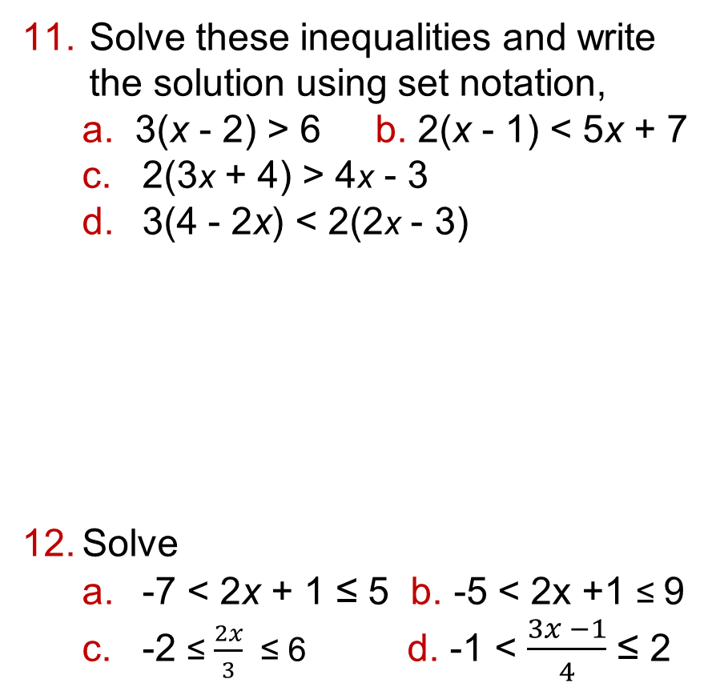
9.7 - Solving Linear Inequalities
Page 295
Solve these inequalities and write the solution using set notation,
  3(x - 2) > 6 b. 2(x - 1) < 5x + 7
  2(3x + 4) > 4x - 3
  3(4 - 2x) < 2(2x - 3)
Solve
  -7 < 2x + 1 ≤ 5 b. -5 < 2x +1 ≤ 9
  -2 ≤ $\frac{2x}{3}$ ≤ 6 d. -1 < $\frac{3x −1}{4}$ ≤ 2
Q11 hint - Expand the brackets first.
Key Point 12
When inequalities have a lower limit and an upper limit, solve the two sides separately.
Q12a hint - Write the two inequalities separately: -7 < 2x + 1 and 2x + 1 ≤ 5. Solve each one separately.

Slide 69
9.7 - Solving Linear Inequalities
Page 295
a. Multiply both sides of the inequality 5 > 3 by -1. Is the inequality still true?
  Divide both sides of the inequality 8 < 16 by -2. Is the inequality still true?
Discussion What happens when you multiply or divide an inequality by a negative number?
Key Point 13
When you multiply or divide an inequality by a negative number, reverse the inequality signs.

Slide 70
9.7 - Solving Linear Inequalities
Page 295
Find the possible integer values of x in these inequalities,
  -8 < -x < -2 b. -4 < -2x < 10
  -8 < 4 - 3x ≤ 10
  -6 ≤ 4 – 2x ≥ 8
Solve these inequalities and write the solution using set notation,
  3(x + 2) ≥ 2x + 3
  2 - x < 2x + 5
  -3 < 2x + 1 ≤ 9
  -2 > 4(1 - x) ≥ -8

Slide 71
9 - Problem Solving - Overtaking
Page 296
Objectives | Be able to substitute into formulae. Be able to factorise quadratic expressions. Be able to solve linear and quadratic simultaneous equations.
If a vehicle is accelerating at a constant
rate we can use the formula below to
find the distance it has travelled after a certain time.
Find the distance travelled by a car
in 10 seconds if its acceleration is
8 m/s² and it starts at a speed of 5 m/s.
A car is travelling at a constant speed of 3 m s⁻¹. At time t = 0 it starts to accelerate at 4 m/s². At what time will it have travelled 20 m?
s = ut + ½at²
s = distance (m)
u = initial velocity (m/s)
a = acceleration (m/s²)
t = time (s)
Q2 hint - Substitute into the formula and factorise to solve the quadratic equation. Which solution would be the correct answer?.

Slide 72
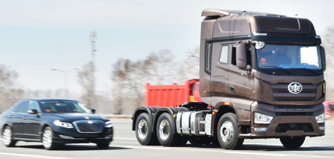
9 - Problem Solving - Overtaking
Page 296
A car leaves a set of traffic lights from stationary and accelerates at a constant rate of 6 m/s². A lorry passes the traffic lights just as they go green. It is travelling at a constant speed of 18 m/s.
How many seconds after it leaves the traffic lights does the car overtake the lorry?
Q3 hint – Use s = ut + ½at² to find the equation that models the car leaving the set of traffic lights. You could answer this problem by drawing distance-time graphs for the car and the lorry on the same set of axes (time from 0s to 18s).

Slide 73
9 - Problem Solving - Overtaking
Page 296
At the next set of traffic lights the car stops and waits for the lights to go green.
When the lights change, it accelerates at a constant rate and is overtaken by a motorcycle travelling at a constant speed.
  Find equations for both vehicles so that the car overtakes the motorcycle after 5 seconds,
  Can you find more than one solution to this problem?

Slide 74
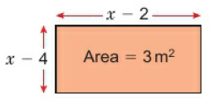
9 - Checkup
Page 297
Checkup | Log how you did on your Student Progression Chart.
Quadratic equations
Solve
  x² + 3x = 0
  2x² + 2x - 12 = 0
Factorise 3x² - 4x - 4 = 0
Write and solve an equation to find x.

Slide 75
9 - Checkup
Page 297
Quadratic equations
Use the quadratic formula to solve x² - 2x - 6 = 0
Give your answer in surd form.
Write x²+ 6x + 3 in the form
(x + p)² + q
Solve x² + 6x - 3 = 0 by completing the square, giving your answer in surd form.

Slide 76
9 - Checkup
Page 297
Simultaneous equations
Solve these simultaneous equations,
  y = x + 3 b. 2x + y = 4
  x - 2y = -1 3x + 2y = 6
Problem-solving Find the equation of the line through the points (4, 5) and (0, -3).
Solve these simultaneous equations.
  2x + y = 5
  x² + 2x = y

Slide 77
9 - Checkup
Page 297
Inequalities
10 Find the possible integer values for x in -10 < -5x =£ 25
a. Solve the inequality
-3 < x - 3 ≤ 6
  Show your answer on a number line,
  Write the solution using set notation.

Slide 78
9 - Checkup
Page 297
Inequalities
How sure are you of your answers? Were you mostly
Just guessing ☹
Feeling doubtful 😐
Confident ☺
What next? Use your results to decide whether to strengthen or extend your learning.
* Challenge
a. My daughter's age in 3 years’ time will be the square of her age 3
years ago. How old is she now?
  Write a problem like this for a
  friend. Check that it works and
  that you can find the answer..
Reflect

Slide 79
9 - Strengthen
Page 298
Checkup | Log how you did on your Student Progression Chart.
Quadratic equations
Solve x(x + 7) = 0
a. Factorise x² + 5x
  Solve x² + 5x = 0
Q1 hint - x x (x + 7) = 0
Either x = 0 or x + 7 = 0
Q2a hint – x(◻ + ◻)
Q2b hint – Use your answer to part a to help. x(◻ + ◻) = 0
Either x = 0 or (◻ + ◻) = 0

Slide 80
9 - Strengthen
Page 298
Quadratic equations
a. Find two numbers whose
product is -12 and whose sum is -1
  Factorise x² - x – 12
  Solve x² - x - 12 = 0
Solve
  x² + 3x - 18 = 0 b. x² - 7x + 12 = 0 c. x² + 2x - 15 = 0
Q3a hint – Which two factors of -12 have a difference of 1? The -12 means the signs are different.
Q3b hint – Use your answer to part a. (x + one factor)(x - other factor)
Q3a h4int – Follow the method used in Q3. Begin by finding two numbers whose product is -18 and whose sum is +3

Slide 81
9 - Strengthen
Page 298
Quadratic equations
a. Write down the factor pairs of –
  Try each factor pair in these brackets.
  (2x + ◻)(x + ◻)
  Which pair gives 2x² + x - 6 when you expand?
  Solve 2x² + x - 6 = 0
Solve
  3x² + 5x - 12 = 0
  3x² - 2x - 8 = 0
  4x² - 14x + 12 = 0
Q5c hint –Use your answer to part b. (2x + ◻)(x + ◻) = 0.
Q6a hint – Follow the method used in Q5

Slide 82
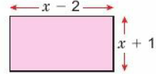
9 - Strengthen
Page 298
a. A rectangle is x cm long and (x - 2) cm wide. Write an expression for its area,
  A square has
  side (x + 4).
  Write an
  expression for its area.
The diagram shows a rectangle.
  Write an expression for the area of the rectangle.
  The area of the rectangle is 4 m². Write an equation for this.
  Rearrange your equation so you have 0 on the right-hand side,
  Solve this equation to find x.
Q8b hint – Use your answer to part a.
Q8d hint – Follow the method used in Q3.

Slide 83
9 - Strengthen
Page 298
What are the values of a, b and c in each of these equations?
  2x² + 3x + 1 = 0
  2x² - 4x - 6 = 0
  3x² + 4x -1 = 0
What is the value of b² - 4ac for each equation in Q9?
Q9 hint –Write each equation below the generaI equation ax² + by + c
2x² + 3x + 1 = 0
Q10 hint – Use the values of a, b and c you found in Q9. Substitute the values into the expression.

Slide 84
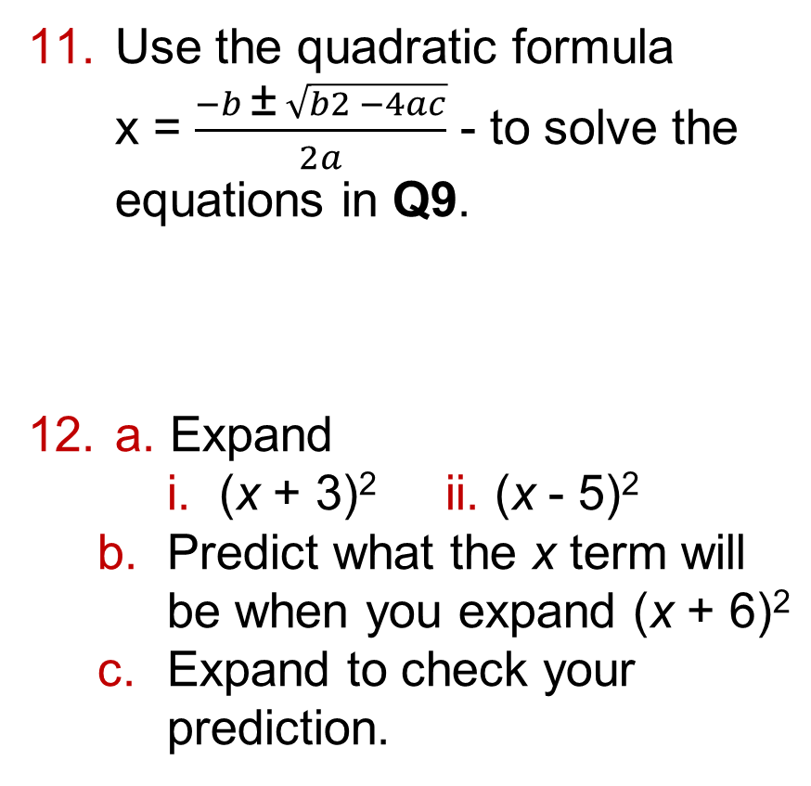
9 - Strengthen
Page 298
Use the quadratic formula
x = $\frac{−b \text{±} \sqrt{b2 −4ac}}{2a}$ - to solve the equations in Q9.
a. Expand
    (x + 3)² ii. (x - 5)²
  Predict what the x term will be when you expand (x + 6)²
  Expand to check your prediction.
Q11 hint – Use the values of
b² - 4ac you found in Q10.

Slide 85
9 - Strengthen
Page 299
a. Copy and complete
(x + ◻)² = x² + 4x + ◻
(x + ◻)² – ◻ = x² + 4x
  Solve x² + 4x = 8 by completing the square.
a. Copy and complete
(x - ◻)² = x² - 6x + ◻
(x - ◻)² – ◻ = x² - 6x
  Solve x² - 6x = 9 by completing the square.
Q13b hint – Use your answer from part a. Rearrange so you have ( )² = ◻. Take square roots of both sides.
Q14b hint – Follow the method used in Q13.

Slide 86
9 - Strengthen
Page 299
Simultaneous equations
Solve 3x + y = 10 when
  y = 3 b. y = 2x
Solve the simultaneous equations
  4x + y = 12 and y = 2x
Q1a hint – Substitute 3 in place of y and rearrange to find x
Q1b hint – Substitute 2x in place of y and rearrange to find x
Q2 hint – Follow the method used in Q1.

Slide 87
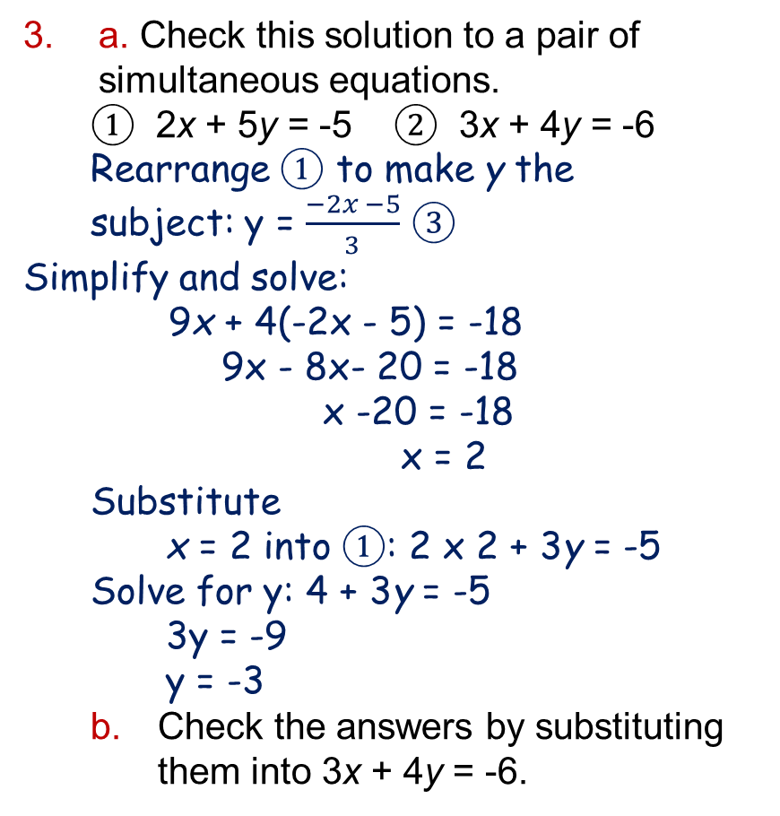
9 - Strengthen
Page 299
a. Check this solution to a pair of simultaneous equations.
① 2x + 5y = -5 ② 3x + 4y = -6
Rearrange ① to make y the subject: y = $\frac{−2x −5}{3}$ ③
Simplify and solve:
9x + 4(-2x - 5) = -18
9x - 8x- 20 = -18
x -20 = -18
x = 2
Substitute
x = 2 into ①: 2 x 2 + 3y = -5
Solve for y: 4 + 3y = -5
3y = -9
y = -3
  Check the answers by substituting them into 3x + 4y = -6.

Slide 88
9 - Strengthen
Page 299
Solve the simultaneous equations
3x + 2y = -8
3y -2x = 14
Here are two simultaneous equations.
x² - 2x = 6 + y
5x + y = 14
  Rearrange 5x + y = 4 to make y the subject,
  Substitute your answer to part a in place of y in the first equation,
  Simplify the equation by collecting like terms,
  Solve the quadratic equation,
  Substitute for x to find y.
Q4 hint – Write them with x and y terms above each other. Follow the method used in Q3.

Slide 89

9 - Strengthen
Page 299
Solve the simultaneous equations
x² + 4x = 4 + y
y + x = 2
Inequalities
Write the inequalities for these number lines,
Q6 hint – Follow the method used in Q5.
-2 x 1
4 x 10
Q1 hint
● ≤ or ≥ O
O < or >
3 x 8

Slide 90
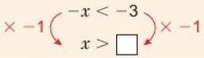
9 - Strengthen
Page 300
a. Show these inequalities on number lines.
    x > 3 ii. x ≤ 7 iii. 3 ≤ x < 7
  Write two integer values that satisfy each inequality.
Draw a number line to show each inequality,
  x ≥ 0 b. x < 0 or x ≥ 1
  -2 < x ≤ 4 d. -4 ≤ x ≤ 4
  Write all the possible integer values for c and d.
Solve these inequalities,
  x – 3 > 5 b. 7 - x < 4
  -2 < x + 1 < 5
  0 ≤ x - 4 ≤ 8
Q4 hint - Solve using the same method as for an equation. Remember:

Slide 91
9 - Strengthen
Page 300
a. Solve 2 < 3x - 1
  Solve 3x - 1 < 11
  Find the possible integer values for 2 < 3x – 1 < 11
Find the possible integer values for 4 < 4x + 5 ≤ 9
Q5c hint - Use your answers from a and b to write ◻ < x < ◻
Q6 hint - Follow the method used in Q5.

Slide 92
9 - Strengthen
Page 300
Show the solutions to Q5 and Q6 on number lines.
In set notation, x ≤ 3 is (x : x ≤ 3). Write these inequalities in set notation:
  x > 4
  x < 7
  x ≥ 5
  0 ≤ x < 3
Q8 hint - Write (x : ) around the inequality.

Slide 93
9 - Extend
Page 300
Extend
The product of two consecutive numbers is 30.
  Write this using algebra,
  Solve your equation to find the two numbers.
A lawn is 4 m longer than it is wide. The total area of the lawn is 30 m².
What is its perimeter? Give your answer to 2 decimal places.
Q1a hint – Use x for the first number. The next consecutive number is x + ◻

Slide 94
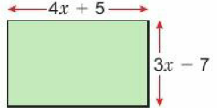
9 - Strengthen
Page 300
Write 3x² + 2.4x in the form a(x + p)² + q. State the values of a, p and q.
Reasoning The football pitch in the diagram has area 7140 m². What are the dimensions of the pitch?

Slide 95
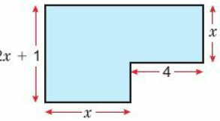
9 - Strengthen
Page 300
The diagram shows a 6-sided shape.
All the corners are right angles and all the measurements a re in centimetres.
The area of the shape is 75cm².
  Show that 2x² + 5x - 75 = 0
  Solve the equation
  2x² + 5x -75 = 0

Slide 96
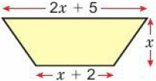
9 - Strengthen
Page 301
Problem-solving Gary buys three mobile phone cases and two charging leads and pays £29.50. At the same time his friend buys two phone cases but takes a charging lead back, gets a full refund on it and pays £11.50.
What is the cost of a mobile phone case? What is the cost of a charging lead?
Reasoning This trapezium has area 20 m².
The area of a trapezium is given by the formula
A = ½(a + b)h
Find the value
of x.

Slide 97
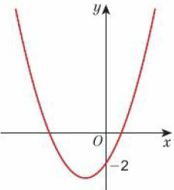
9 - Strengthen
Page 301
The diagram shows a sketch of the curve y = 2x² + 4x - 2
The line y = 6 - x crosses the curve at points A and B.
Use an algebraic
method to find the
coordinates of A
and B. Give your
answers to 1
decimal place.
A ball thrown in the air travels at speed s = (20 – 4t metres per second, where t is the time after being thrown. For which values of t is the speed between 5m/s and 15m/s?

Slide 98
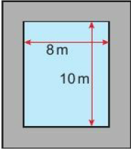
9 - Strengthen
Page 301
Reasoning Jodie and Kate play netball for the same team.
In a month they score fewer than 15 goals. Kate scored 4 more goals than Jodie. What is the maximum number of goals Jodie could have scored?
Problem-solving A pond is 8 m wide by 10 m long.
It has a path around
it that is exactly the
same width all round.
The area of the path
is 80% of the area of
the pond.
How wide is the path?
Q9 hint – Write and solve an inequality

Slide 99
9 - Strengthen
Page 301
12 – Exam-Style Questions
Solve the simultaneous equations
X² + y² = 25
y = 2x + 5 (6 marks)
Nov 2012, Q2I, 5MB3H/01J
Exam hint
Write your solutions in two pairs
x = ◻, y = ◻ and x = ◻, y = ◻
Solve x – 4 < 3x + ≤ 9.
Show the solutions on a number line and write as a solution set.

Slide 100
9 - Strengthen
Page 301
Communication
  Show that
  (x + p)² + q = x² + 2px + p² + q
  Jake uses this method to write x² + 4x + 5 in the form: (x + p)² + q(x + p)² + q = x² + 2px + p² + q = x² + 4x + 5 Comparing the x terms:
  2px =4x so 2p = 4, p = 2
  Comparing number terms:
  p² + q = 5
  4 + q = 5
  q = 1
  So (x + p)² + q = (x + 2)² + 1
  Use Jake's method to write these expressions in the form (x + p)² + q
  i. x² + 6x + 15 ii. x² + 8x - 3
  iii x² - 4x + 2 iv x² + 3x + 7
Q14a hint - Expand and simplify the LHS.

Slide 101
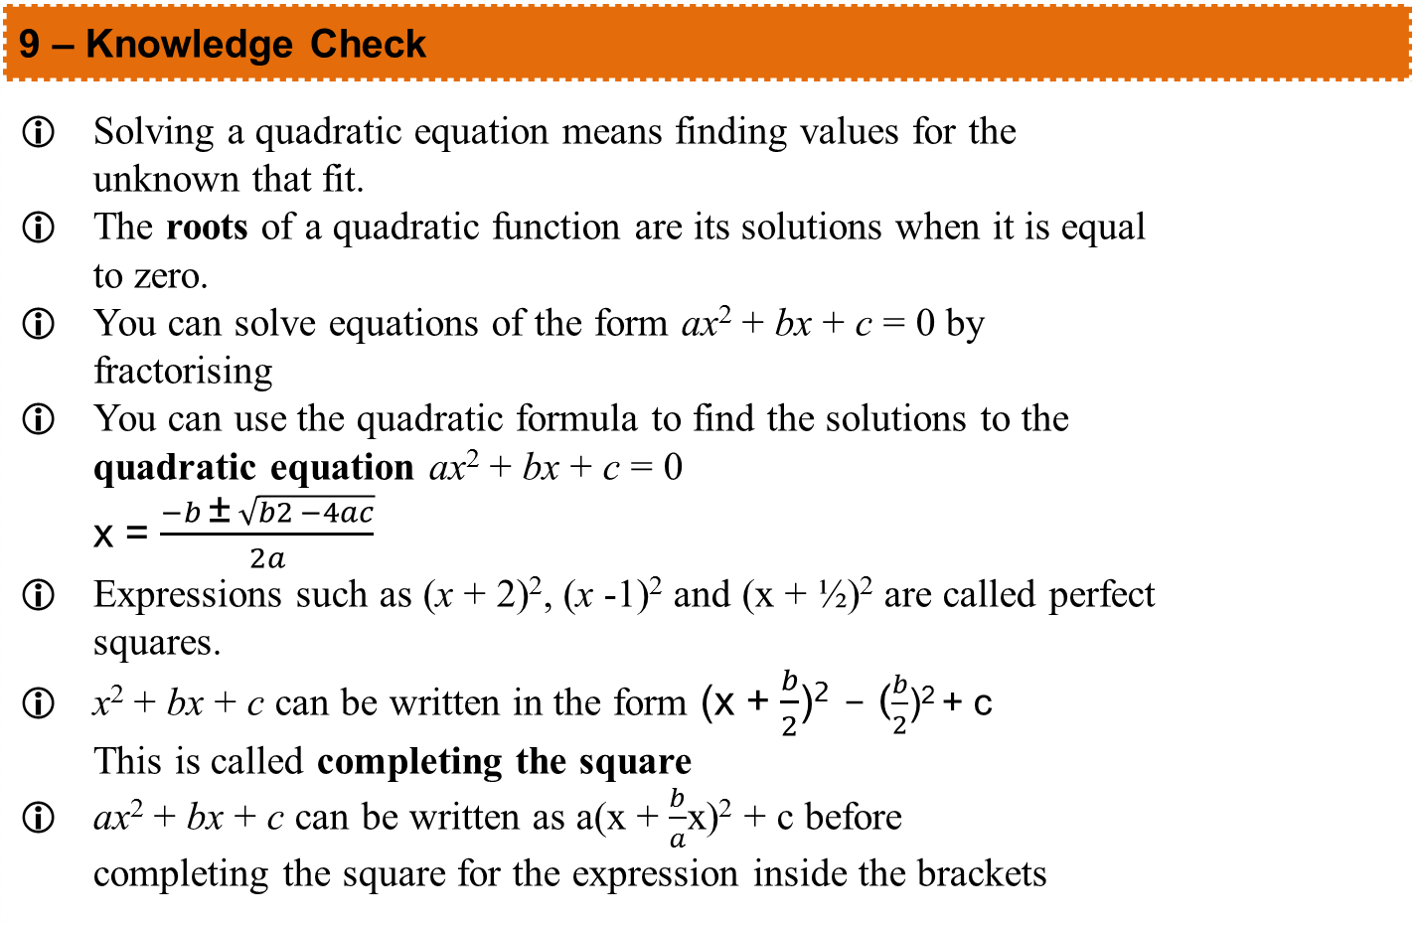
9 – Knowledge Check
Page 276
9 – Knowledge Check
Solving a quadratic equation means finding values for the unknown that fit. The roots of a quadratic function are its solutions when it is equal to zero. You can solve equations of the form ax² + bx + c = 0 by fractorising You can use the quadratic formula to find the solutions to the quadratic equation ax² + bx + c = 0 x = $\frac{−b \text{±} \sqrt{b2 −4ac}}{2a}$ Expressions such as (x + 2)², (x -1)² and (x + ½)² are called perfect squares. x² + bx + c can be written in the form (x + $\frac{b}{2}$)² – ($\frac{b}{2}$)² + c This is called completing the square ax² + bx + c can be written as a(x + $\frac{b}{a}$x)² + c before completing the square for the expression inside the brackets
Mastery
Lesson 9.1
Mastery
Lesson 9.2
Mastery
Lesson 9.2
Mastery Lesson 9.3
Mastery Lesson 9.3

Slide 102
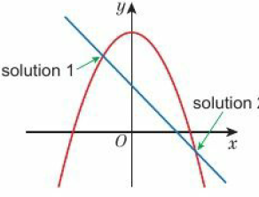
9 – Knowledge Check
Page 302
9 – Knowledge Check
When there are two unknowns, you need two equations to find their values. These are called simultaneous equations. A pair of quadratic and linear simultaneous equations can have two possible solutions. To find the coordinates where two graphs intersect, solve their equations simultaneously. You can show inequalities on a number line. An empty circle O shows that the value is not included. A filled circle ● shows that the value is included. An arrow O shows that the solution continues towards infinity. You can rearrange an inequality in the same way as you rearrange an Equation
Mastery
Lesson 9.4
Mastery
Lesson 9.5
Mastery
Lesson 9.5
Mastery Lesson 9.7
Mastery Lesson 9.7

Slide 103
9 – Knowledge Check
Page 302
9 – Knowledge Check
You can write the solution to an inequality using set notation. [x: x > 2] the set of x such that When inequalities have a lower limit and an upper limit, solve the two sides separately. When you multiply or divide an inequality by a negative number, reverse the inequality signs. For this unit, copy and complete these sentences. I showed I am good at__________ I found __________ hard I got better at __________ by __________ I was surprised by __________ I was happy that __________ I still need help with __________
Mastery
Lesson 9.7
Mastery
Lesson 9.7
Mastery
Lesson 9.7
Reflect

Slide 104
9 – Unit Test
Page 303
9 Unit Test | Log how you did on your Student Progression Chart.
Solve the quadratic equation
15 = 2x² - 7x (3 marks)
Factorise 9x² - 3x – 2 (2 marks)
Reasoning
  One side of a rectangular room is 2 m longer than the other side.
  Write the area of the room as an expression in x (the length of the shorter side). (1 mark)
  The area of the room is 15m². What is the value of x? (3 marks)

Slide 105
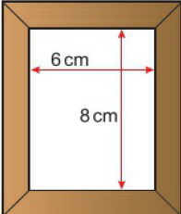
9 – Unit Test
Page 303
Solve the equation 3x² – 2x - 2 = 0.
Give your solutions to 3 significant figures. (3 marks)
Problem-solving A picture frame is designed to take a 6cm x 8cm picture. The
border is exactly
the same width
all round and its
area is 32cm².
How wide is the
border?
(3 marks)

Slide 106
9 – Unit Test
Page 303
Solve these simultaneous equations,
  3x - 2y = 5
  4x + 2y -16 (3 marks)
  5x + 2y = 18
  2x + 3y = 5 (4 marks)
Problem-solving Jay buys 2 apples and 3 pears in a supermarket and pays £1.90.
He later returns and buys 4 pears and 5 apples and pays £3.35.
What is the cost of one apple? What is the cost of one pear?
(5 marks)

Slide 107
9 – Unit Test
Page 303
Solve the inequalities
    2y + 6 < 4y + 8 (3 marks)
    -3 < 2(x - 4) ≤ 6 - x (3 marks)
Find the integer x that satisfies both the inequalities x + 4 > 5
and 3x - 4 < 5 (3 marks)
A curve with equation
y = x²- 6x - 2 crosses a straight line with equation y = 3x - 2 in two places. Find the coordinates of the points where they intersect. (4 marks)

Slide 108
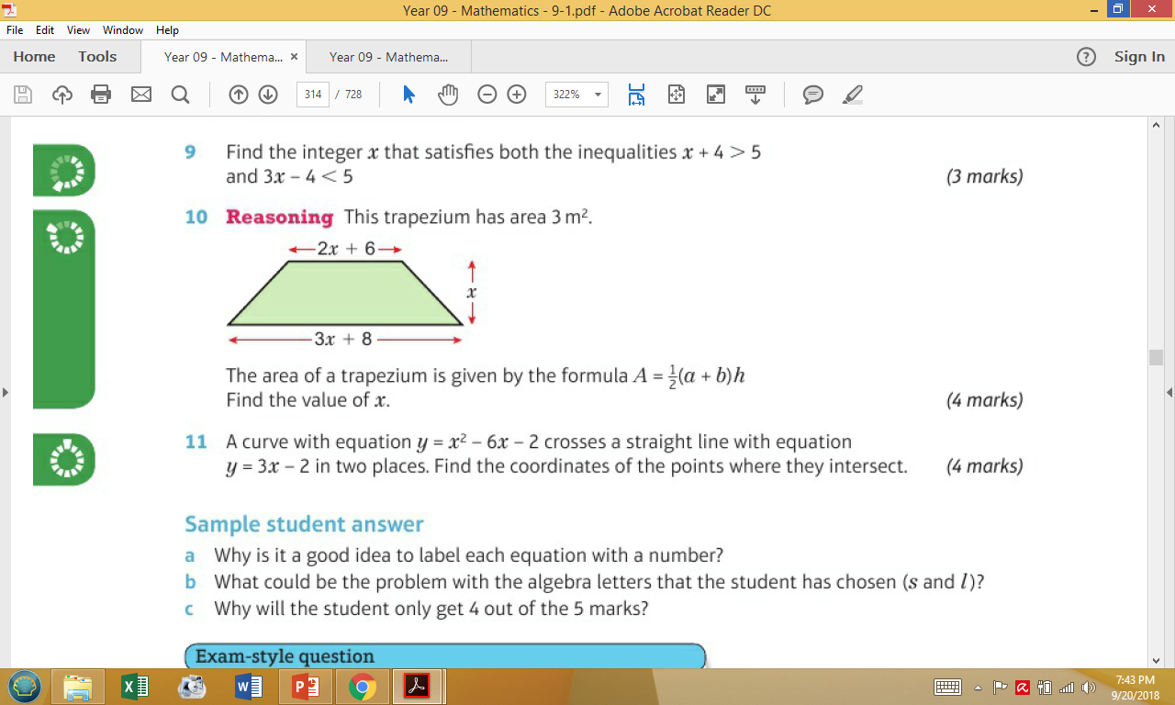
9 – Unit Test
Page 304
Reasoning This trapezium has area 3m².
The area of a trapezium is given by the formula
A = ½(a + b)h
Find the value of x. (4 marks)

Slide 109
9 – Unit Test
Page 304
Sample student answer
  Why is it a good idea to label each equation with a number?
  What could be the problem with the algebra letters that the student has chosen (s and l)?
  Why will the student only get 4 out of the 5 marks?
14 – Exam-Style Questions
Paper clips are sold in small boxes and in large boxes.
There is a total of 1113 paper clips in 4 small boxes and 5 large boxes.
There is a total of 530 paper clips in 3 small boxes and
2 large boxes.
Work out the number of paper clips in each small box
and in each large box. (5 marks)
June 2014, Q17, 5MB3H/01

Slide 110
9 – Unit Test
Page 304
Student answer
4s + 5l = 1115
① x 3: 12s + 15l = 334 ③
② 3s + 2l = 530
② x 4: 12s + 8l = 2120 ④
③ - ④: 7l = 1225
1225 + 7 = 175
Put into ②:
3s + 350 = 530
3s = 180
s = 60

